Slide 1
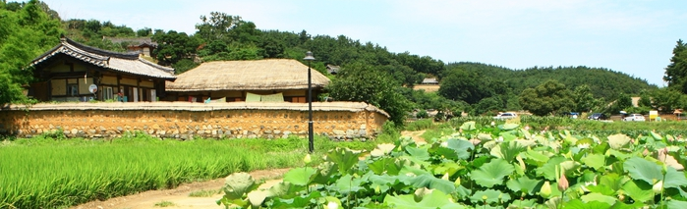
YanGdong Village Residents` attitude toward Tourism: A Q Method Study
Grilli Lucia Adviser: William C. Hunter
Kyung Hee University
8th April
Source: Yandong Village Official Site
Keywords
Perception, impact, identity, Q method, subjectivism, UNESCO, heritage, community, sustainability, Guest- Host relation, stakeholders

Slide 2
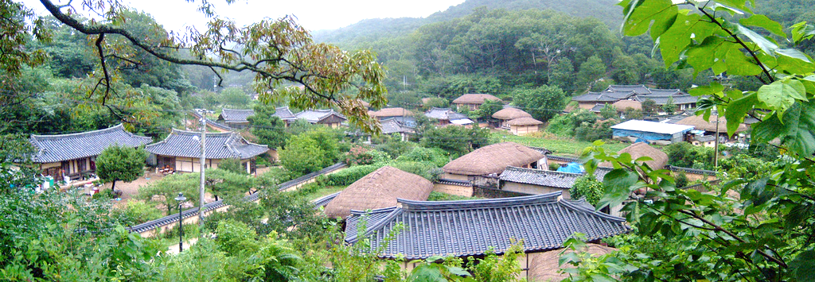
Table of Contents
Source: Yandong Village Official Site
Propose Statement
Aims and Goals
Literature Review
Methodology
Results & Limitations
Q & A
References

Slide 3
Propose Statement
Individuation and classification of factors that influence subjectivities about tourism have been object of study since 70s.
A multidimensional approach is necessary to individuate how from these factors influence the residents` attitude (Sharpley, 2014).
Local history, geographical position, community demographic characteristics, cultural assets, etc. need to be considerate among the other factors (Tosun, 2002).
The aim of this paper is to individuate clusters of subjectivities among residents. The screening of previous studies on resident`s behavior, combined with historic, geographic cultural assets of Yangdong Folk village will be the basis of the study.

Slide 4
Aims and Goals
To analyze the impact of tourism on social, economic, environmental aspects (Mathieson & Wall, 1982).
To understand how local history, geographical position, community demographic characteristics, cultural asset, etc. has influenced positively or negatively villagers and to reconstruct historical changes in community life due to tourism.
To individuate conflicts and problems within the tourism industry.
To identify possible improvements in the relation between host-guest and host-tourism stakeholders.

Slide 5
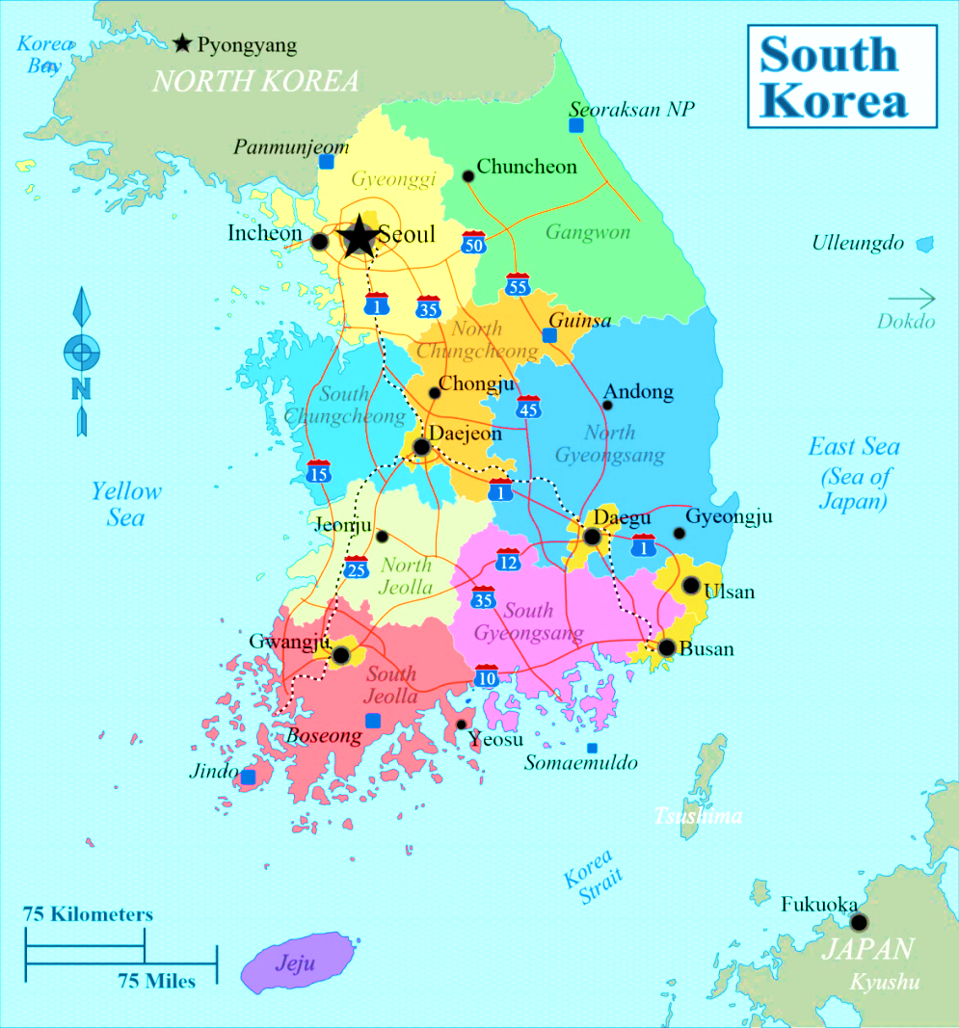
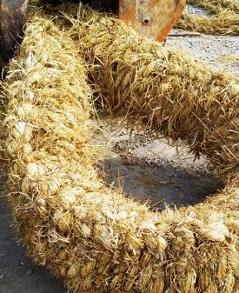
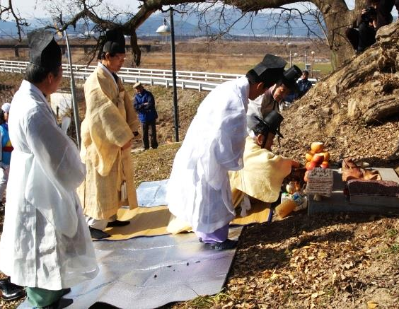
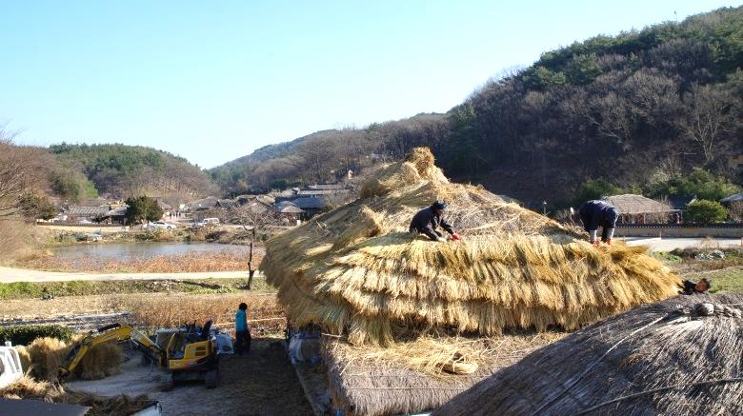
Literature Review
Part 1 | Part 2 | Part 3 | Part 4 | Part 5
Yangdong Folk Village | Cultural Tourism | Effects of Tourism Development | Previous Studies on residents` attitude | Sustainable Tourism Definition
Official Name: Gyeongju Yangdong folk village
Location: South Korea, North Gyeongsang Province
N. Resident: about 300
Origin: Early Joseon Dinasty (1392-1910)
Founded by Walsong Clan member Son So (孫昭) and successively house of both Yi and Son Families.
Characteristics: The village preserved its appearance and traditions for more than 500 years.
It is the biggest “living” folk village in South Korea.
Important events:
1950-54 Korean War: forced evacuation
1970-80 Park Chung Hee New Village movement
1980 Urbanization due industrialization
1987 & 1993 Natural catastrophes: Flooding
Acts for preservation:
1984 National folklore material n.189.
2010 inscription in UNESCO list.

Slide 6
Literature Review
Part 1 | Part 2 | Part 3 | Part 4 | Part 5
Yangdong Folk Village | Cultural Tourism | Effects of Tourism Development | Previous Studies on residents` attitude | Sustainable Tourism Definition
UNESCO (1999) defines with these words cultural tourism: “…the whole complex of distinctive spiritual, material, intellectual and emotional features that characterize a society or social group. It includes not only arts and letters, but also modes of life, the fundamental rights of the human being, value systems, traditions, and beliefs…”
Doinarie (2008)
Cultured tourism | Motivation to understand the culture and the meaning behind the place
Monumental tourism | Interest in the place and buildings of cultural destination
Heritage tourism | Interpret monuments as symbol of the past
Ethnological tourism | Both tangible and intangible are part of the tourism
‘Touristified’ culture | Tourism is a way to merchandise the culture
The extraordinary trip | The travel is a way to enrich himself and every time unique.
Which of this typologies can describe the cultural tourism in Yangdong?

Slide 7
Literature Review
Part 1 | Part 2 | Part 3 | Part 4 | Part 5
Yangdong Folk Village | Cultural Tourism | Effects of Tourism Development | Previous Studies on residents` attitude | Sustainable Tourism Definition
Tourism Development
Economic
Social
Environmental
Positive
Negative
Positive
Negative
Positive
Negative
1. Multiplier Effect 2. New Jobs 3. Improvement of infrastructure 4. Improve standard of life | 1. Unskilled and seasonal job 2. Not /Low economic income 3. Increase of costs` life
1. Revitalization of local culture 2. Leisure activities 3. Cultural exchange | 1.Commodification 2. Rose of delinquency 3. Corruption of morality & customs 4. Conflicts Host- Guest 5. Demonstration effect
1. Protection of natural resources | 1. Litter 2. Pollution 3. Water scarcity
Source: Adapted from García & al., 2015

Slide 8
Literature Review
Part 1 | Part 2 | Part 3 | Part 4 | Part 5
Yangdong Folk Village | Cultural Tourism | Effects of Tourism Development | Previous Studies on residents` attitude | Sustainable Tourism Definition
Studies on single factors or Frameworks
Studies on general theories
1. Economic dependence
2. Level of tourism development
3. Attachment
4. Distance
5. Level of knowledge about tourism
6. Type of tourist
7. Type and level of contacts
8. Access to recreational activities
9. Demographic characteristics
1. The Doxey Irridex Model (1975)
2. Dogan (1989)
3. Butlers` Tourism Area Life Circle (1980)
Explain the relation between residents attitude and stage of tourism development (temporal)
4. Social Exchange Theory (Ap, 1992)
Seems to explain how different factors influences on peoples` attitude.
Anyway…
If this factors influences positively or negatively residents` attitude is not clear.
However…
the application of this theory is not always positive.
Notes:
Now it is important to understand how this effects can be perceived and how they influences positively or negatively the opinion of residents on tourism development.
There have been a lot of

Slide 9
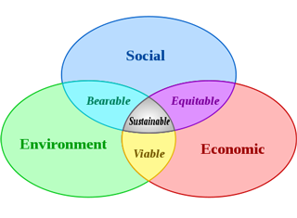
Literature Review
Part 1 | Part 2 | Part 3 | Part 4 | Part 5
Yangdong Folk Village | Cultural Tourism | Effects of Tourism Development | Previous Studies on residents` attitude | Sustainable Tourism Definition
Sustainable Tourism Model
Sustainable Cultural Tourism Directions
1 | Attention to climate changes
2 | Attention to intrinsic value to the cultural heritage of historic towns and cities.
3 | Showing respect and admiration to reality rights and beliefs of local cultures
4 | Importance of economical support of tourism for local community
5 | Preserve cultural heritage assets
6 | Pay attention to the needs of locals, must be involved in development and planning.
7 | Justice and fairness are crucial to long term sustainability and cultural tourism should provide benefits equitably to the local communities.
8 | All local stakeholders including local government and politics, local groups of people and businesses, must be involved in the development of management planning.
9 | Cultural tourism must react and respond to the lacking things of visitor and help to achieving a high quality visitor experience.
10 | The impact of tourism should be assessed according to the value of consumers and producers.
11 | The management and development of cultural tourism should be responsive to change.
Source: Wikipedia
Source: EAHTR, 2016

Slide 10
Q Method
Q method is a methodology that helps to study subjectivity (Robbins, & Krueger, 2000).
Q method has been described as an approach for the scientific study of subjectivity (Stephenson 1953).
Stephenson propose a method to reconstruct “point of views”, expressed by peoples` behavior, without use traditional quantitative methods.

Slide 11
Q Method: Stages
Discourse
Q set
P set
Perfoming Q
Primary and Secondary resources:
1) Three Interviews
2) Literary Rev.
3) Online resources
42 Statements
Deduced from the discourse divided in 4 categories:
1) Identity and Culture
2) Tourism Development
3) Tourism Behavior
4) Community Impacts
30 people
Will be selected to perform the study:
Reasoned sampling
9 poles score sheet
Will help to distribute the 42 statement from most disagree (-4) to most agree (+4)
Factor Analysis
Interpretation
PCQ software
Will be used for the data analysis and judgmental rotation will help to group the insert data in clusters.
The researcher
Have to identify the cluster characteristics and explain their actions and feeling about the issue.

Slide 12
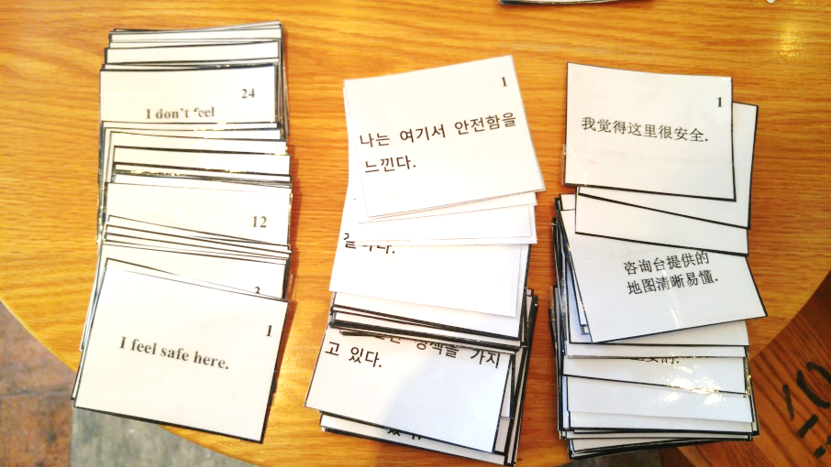
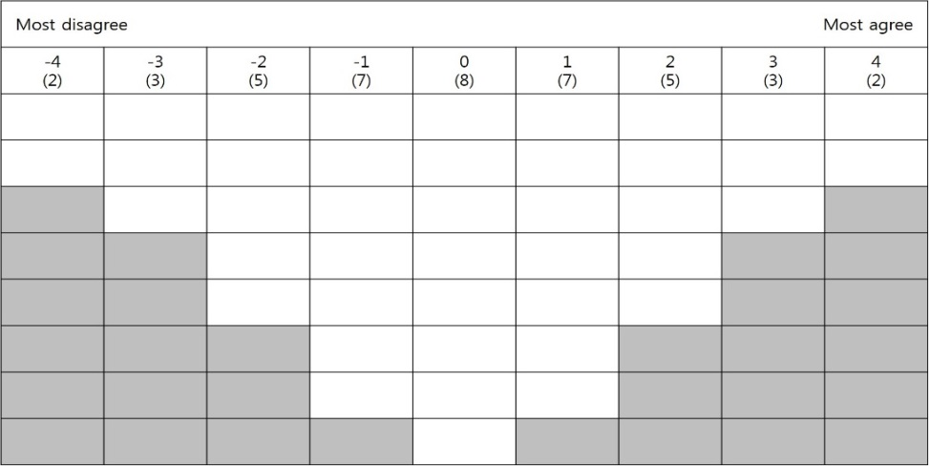
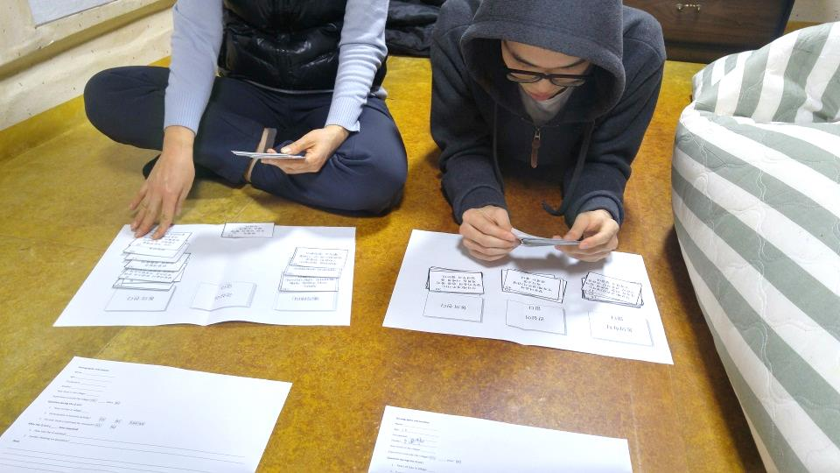

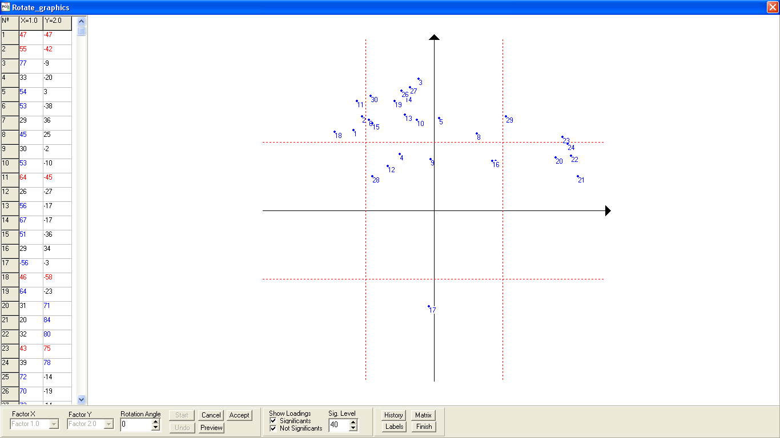
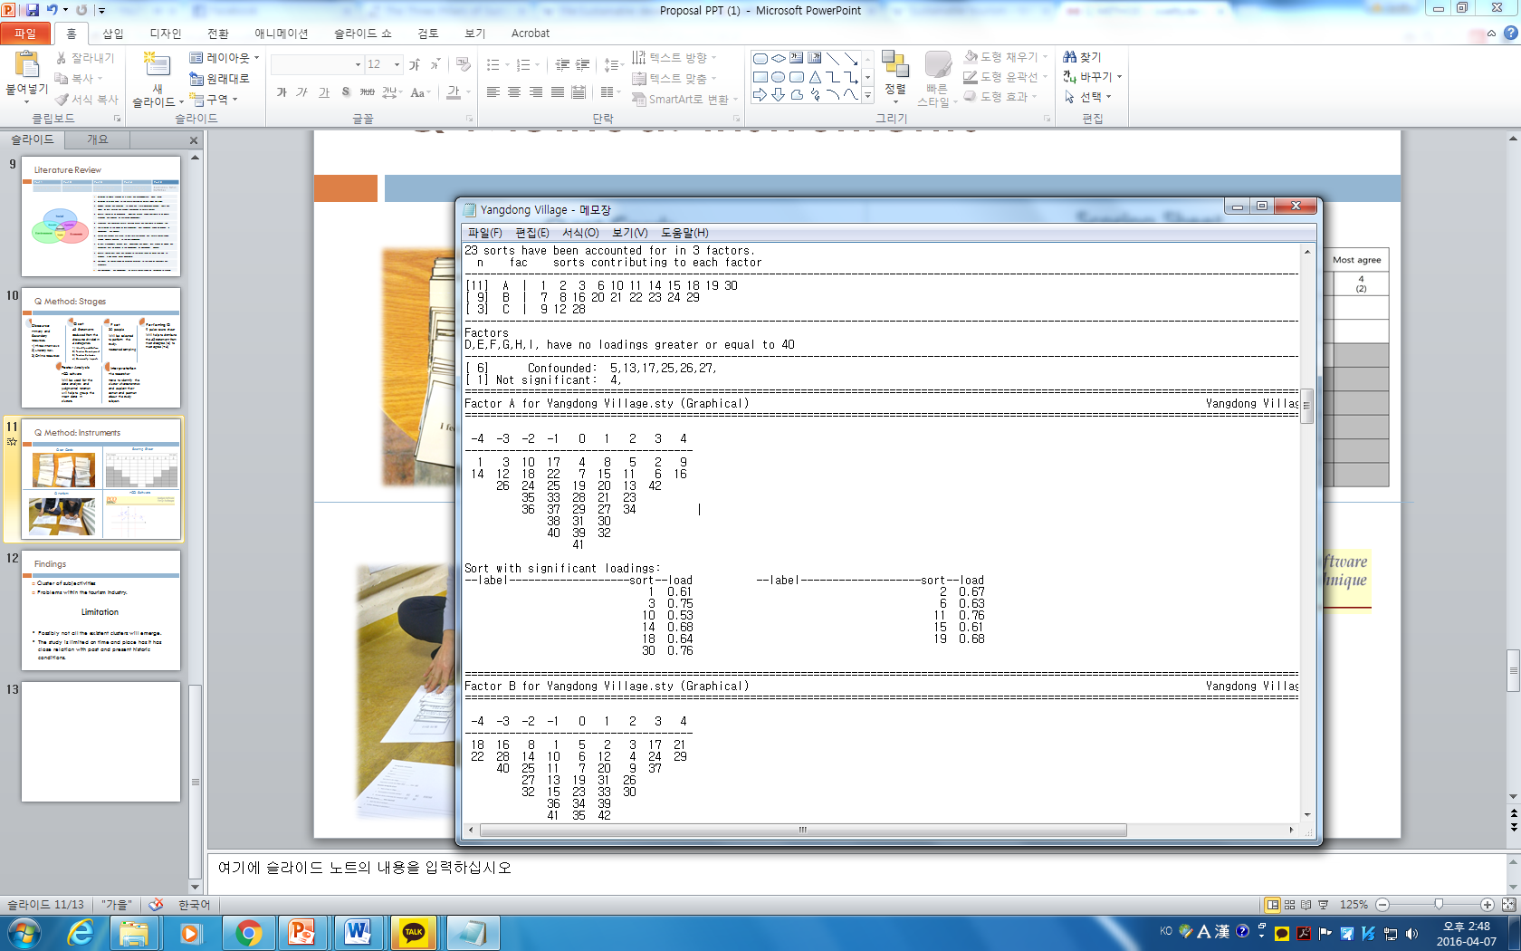
Q Method: Instruments
Q set Cards
Scoring Sheet
Source: Personal Photo
Source: http://www.mdpi.com/2071-1050/6/3/1521/htm
Q Perform
PCQ Software
Source: Personal Photo
Source: http://www.pcqsoft.com/

Slide 13
Findings
Cluster of subjectivities: different attitudes toward tourism in Yangdong Village
Help to individuate problems within the tourism industry.
Provide useful information for the future planning for tourism development.
Limitation
It is possible that not all the existent clusters will emerge, depends from the sample of the study.
The study will represent the actual framework of subjectivities and to identify trends and changes that occur over time a longitudinal approach is suggested.

Slide 14
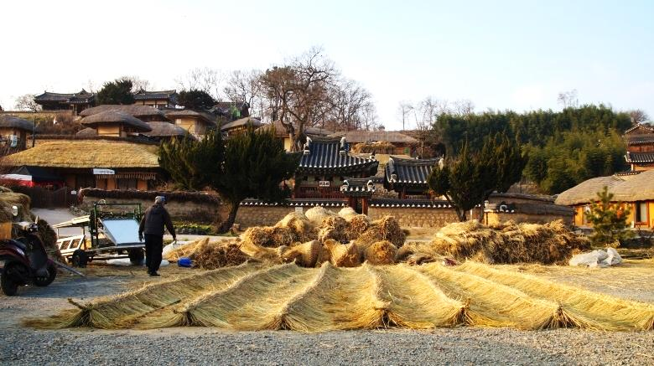
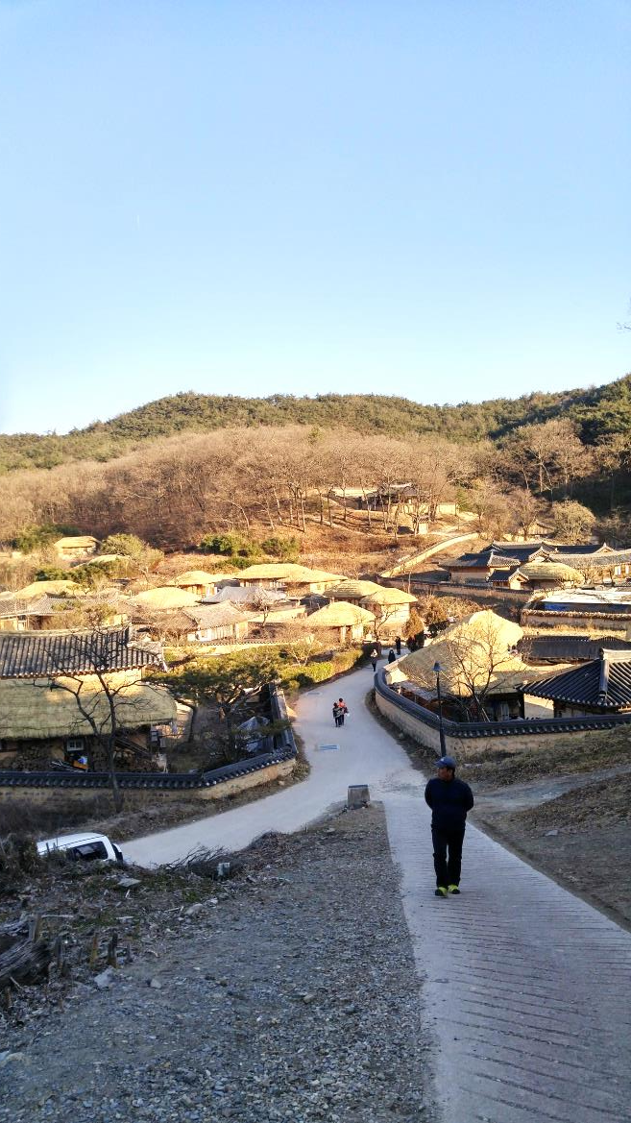
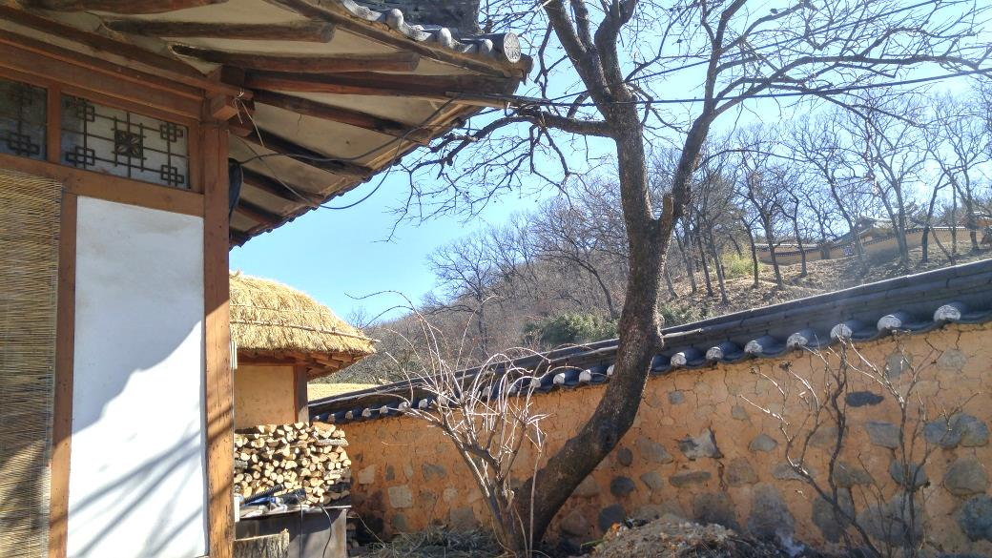
Q & A
Source: Personal Photo

Slide 15
References
Online Soucers
Yangdong Official Website: https://en.wikipedia.org/wiki/Sustainable_development
Sustainable Tourism Wikipedia: https://en.wikipedia.org/wiki/Sustainable_development
References
Dogan H Z, 1989. Forms of adjustment--sociocultural impacts of tourism. Annals of Tourism Research, 16(2): 216-232.
Doxey, G. V. (1975). A causation theory of visitor-resident irritants: Methodology and research inferences. In the impact of tourism sixth annual conference of the travel research Association.
EAHTR (2006). Sustainable cultural tourism in historic towns and cities. United Kingdom.
García, F. A., Vázquez, A. B., & Macías, R. C. (2015). Resident's attitudes towards the impacts of tourism. Tourism Management Perspectives, 13, 33-40.
Sharpley, R. (2014). Host perceptions of tourism: A review of the research. Tourism Management, 42, 37-49.
Robbins, P., & Krueger, R. (2000). Beyond bias? The promise and limits of Q method in human geography. The Professional Geographer, 52(4), 636-648
Tosun, C. (2002). Host perceptions of impacts: A comparative tourism study. Annals of Tourism Research, 29(1), 231–253.

